Slide 1
CSE 3400/CSE 5850 - Introduction to Computer & Network Security / Introduction to Cybersecurity Lecture 3 Encryption – Part II (and Pseudo-randomness)
Ghada Almashaqbeh
UConn
Adapted from textbook slides by Prof. Amir Herzberg
UConn

Slide 2
Outline
One time pad (OTP) encryption.
Pseudorandom number generators (PRGs).
Pseudorandom number functions (PRFs).
Encryption schemes from PRGs and PRFs.
2

Slide 3
We can apply generic, exhaustive attacks to every cryptosystem. So, is breaking just a question of resources? Can encryption be secure unconditionally – even against attacker with unbounded time and storage?
Yes it can!

Slide 4
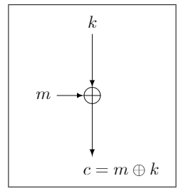
One-Time-Pad (OTP)
[Frank Miller, 1882] and
[Vernham (and Mauborgne?), 1919]
To encrypt message m, compute the bitwise XOR of the key k with the message m:
E_{k}(m)=c where c[i] = k[i] ⊕ m[i]
To decrypt ciphertext c, compute the bitwise XOR of the key with the ciphertext:
D_{k}(c)=m where m[i] = k[i] ⊕ c[i]
1 2 3 4 5 6 7 8
... | 1 | 1 | 1 | 0 | 0 | 0 | 1 | 0
Key k (pad)
Plaintext m
+
Ciphertext c
1 2 3 4 5 6 7 8
1 2 3 4 5 6 7 8
... | 0 | 0 | 0 | 1 | 0 | 0 | 1 | 1
 |  |  |  | 1 | 0 | 0 | 0 | 1

Slide 5
One-Time-Pad: Example, Properties
k = 11001
m = 10011
c = 01010
k = 11001
c = 01010
m = 10011
Correctness: k ⊕ c = k ⊕ (k ⊕ m) = (k ⊕ k) ⊕ m = 0 ⊕ m = m
Very simple, and efficient… but:
Stateful encryption (must remember the keys, or a counter of the key bits, used so far to avoid using them again)
And size of key must be (at least) equal to the message size.
Key cannot be reused for several encryptions (one time!).
Shannon [1949; simplified]: OTP is unconditionally secure, and for every unconditionally-secure cipher, |k|≥|m|
Proofs of these claims? See crypto course / books ☺
To go around the above limitations: we assume attackers are computationally limited

Slide 6
Recall: Unconditional vs. Computational Security
Unconditional security
No matter how much computing power is available, the cipher cannot be broken
Computational security
The cost of breaking the cipher exceeds the value of the encrypted info
The time required to break the cipher exceeds the useful lifetime of the info
So it deals with Probabilistic Polynomial Time (PPT) attackers.
Notes:
Unconditional security would be nice, but the only known such cipher is the one-time pad (later). For all reasonable encryption algorithms, have to assume computational security where it either takes too long, or is too expensive, to bother breaking the cipher.

Slide 7
Looking ahead: Stream Ciphers vs. Block Ciphers
Stream cipher
Encrypts a message bit by bit (stream of bits).
Inherently stateful; needs to keep track of the location of last encrypted bit.
Block cipher
Encrypts a block (string) of bits all at once.
Can be stateless or stateful
Notes:
Unconditional security would be nice, but the only known such cipher is the one-time pad (later). For all reasonable encryption algorithms, have to assume computational security where it either takes too long, or is too expensive, to bother breaking the cipher.

Slide 8
Can we do computationally-secure variant of OTP, with ‘short key’ (|k|<<|m| ) ?
Yes, using pseudorandom number generators (PRGs)!

Slide 9
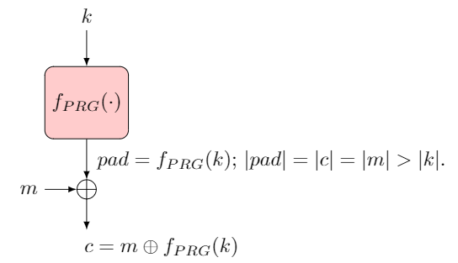
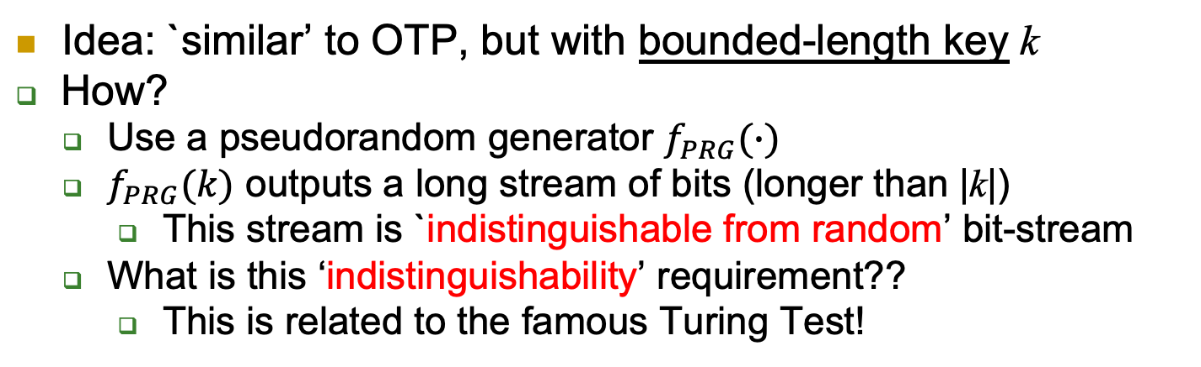
PRG Stream Cipher
Idea: `similar’ to OTP, but with bounded-length key k
How?
Use a pseudorandom generator $f_{PRG}(∙)$
$f_{PRG}(k)$ outputs a long stream of bits (longer than |k|)
This stream is `indistinguishable from random’ bit-stream
What is this ‘indistinguishability’ requirement??
This is related to the famous Turing Test!

Slide 10
PRG Stream Cipher - Example
Seed s
(as key)
PRG
1 2 3 4 5 6 7 8
... | 1 | 1 | 1 | 0 | 0 | 0 | 1 | 0
Bit i of PRG(s)
Bit i of m
c_{i}
Ciphertext c
Plaintext m
+
1 2 3 4 5 6 7 8
1 2 3 4 5 6 7 8
... | 0 | 0 | 0 | 1 | 0 | 0 | 1 | 1
 |  |  |  | 1 | 0 | 0 | 0 | 1

Slide 11



The Turing Test [1950]
Defined by Alan Turing
Machine M is intelligent, if an evaluator cannot distinguish between M and a human
Only textual communication, to avoid `technicalities’
If M is ‘intelligent’, judge will only be able to guess
I.e., probability of distinguishing would be (at most) ½

Slide 12
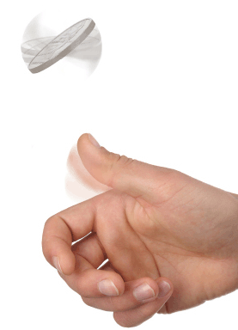
The PRG Indistinguishabity Test
Consider function f from n-bits to m-bits (m>n)
Let seed and rand be random strings s.t.: |seed|=n, |rand|=m
f is a PRG if no efficient distinguisher D can tell which is which.
i.e., cannot output 1 for f(seed) and 0 given rand with non-negligible advantage.
seed (n-bits)
f( )
m-bits
rand
f(seed)
?
m-bits
1 if input is f(seed),
0 if input is rand

Slide 13
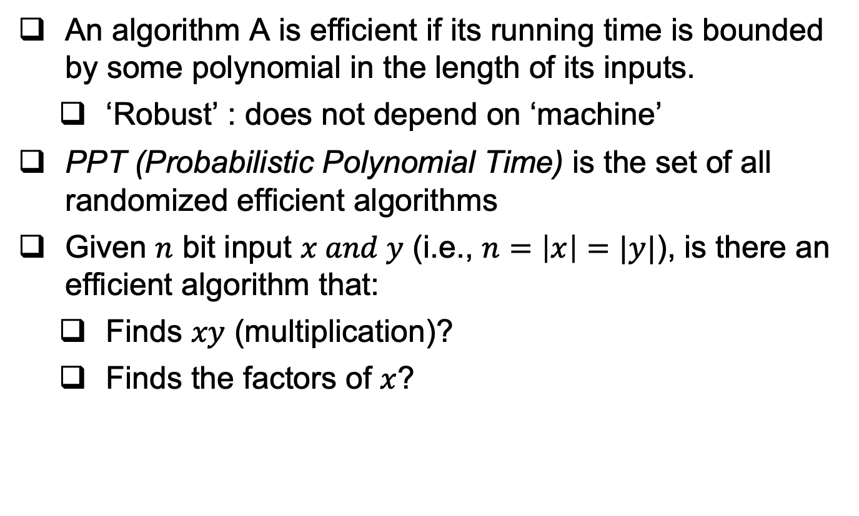
Recall: An Efficient (PPT) Algorithm
An algorithm A is efficient if its running time is bounded by some polynomial in the length of its inputs.
‘Robust’ : does not depend on ‘machine’
PPT (Probabilistic Polynomial Time) is the set of all randomized efficient algorithms
Given $n$ bit input $x and y$ (i.e., $n=\left|x\right|=|y|$), is there an efficient algorithm that:
Finds $xy$ (multiplication)?
Finds the factors of $x$?

Slide 14
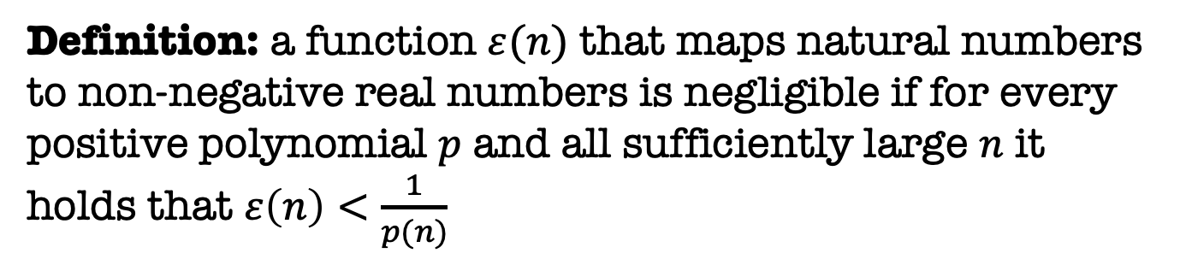
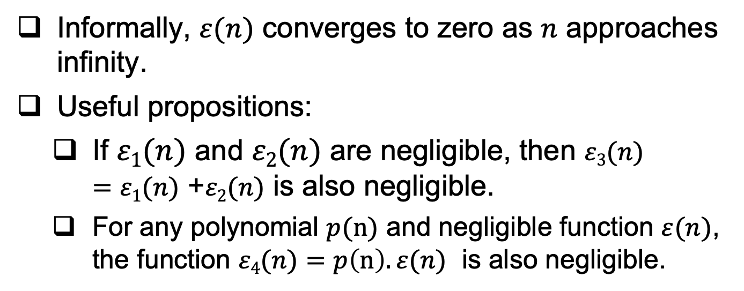
Recall: Negligible Functions
Definition: a function $ε(n)$ that maps natural numbers to non-negative real numbers is negligible if for every positive polynomial $p$ and all sufficiently large $n$ it holds that $ε\left(n\right)<\frac{1}{p(n)}$
Informally, $ε(n)$ converges to zero as $n$ approaches infinity.
Useful propositions:
If $ε1(n)$ and $ε2(n)$ are negligible, then $ε3(n)$ $=ε1(n)$ +$ε2(n)$ is also negligible.
For any polynomial $p(n)$ and negligible function $ε(n)$, the function $ε4(n)$ $=p\left(n\right).ε(n)$ is also negligible.

Slide 15
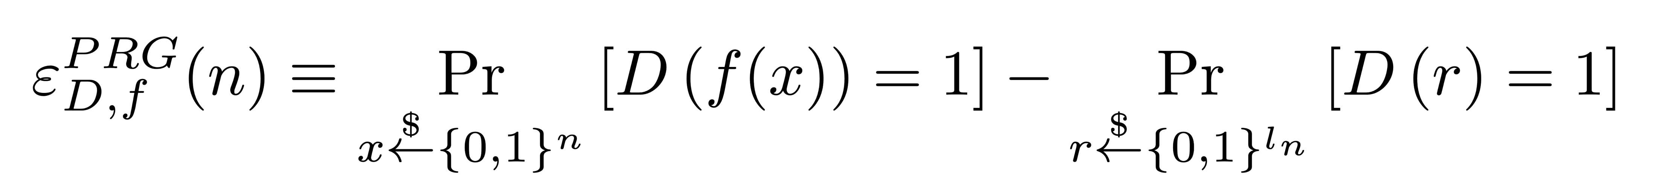
The PRG Advantage
A random guess is correct half of the time
A good distinguisher will have an advantage:
seed (n-bits)
f( )
m-bits
rand
f(seed)
?
m-bits
1 if input is f(seed),
0 if input is rand

Slide 16
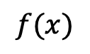

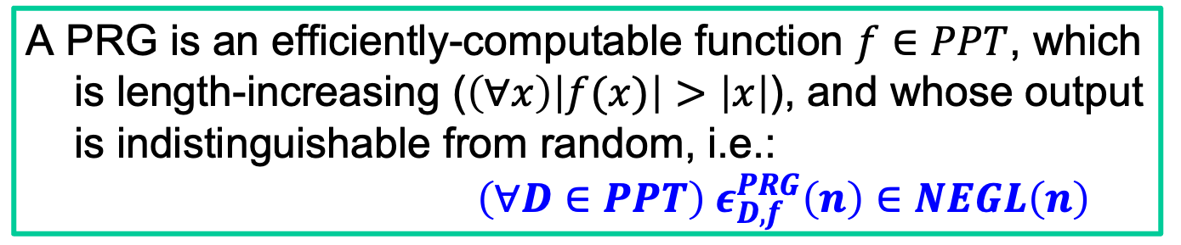
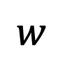
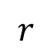
Pseudo-Random Generator: Definition
A PRG is an efficiently-computable function $f∈PPT$, which is length-increasing ($\left(∀x\right)\left|f(x)\right|>\left|x\right|$), and whose output is indistinguishable from random, i.e.: $\left(∀D∈PPT\right) ε_{D,f}^{PRG}\left(n\right)∈NEGL\left(n\right)$
$$f(x)$$
$$w$$
$$r$$
$$x$$ (n-bits)
f(.)
rand

Slide 17
Exercise
Let f(s) be a PRG, are the following PRGs?
g(s) = 1||f(s)
q(s) = (parity of s)||f(s)
w(s) = ~f(s)
~ is the bitwise complement or negation

Slide 18
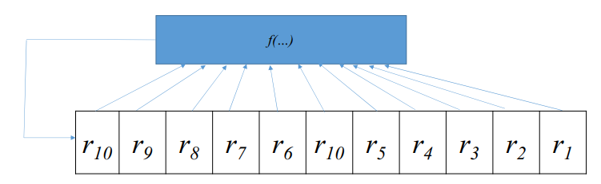
Many PRG proposals I
Often based on Feedback Shift Register(s)
Easy construction for efficient hardware implementations.
Linear feedback (LFSR), or non-linear feedback function (f(…) in the figure, e.g., XOR all previous bits to produce the next one).
LFSR is easily predictable (not secure PRG)

Slide 19
Many PRG proposals II
More complex (multi-registers, etc.), e.g. in GSM
GSM’s original stream-ciphers (A5/1, A5/2): broken
RC4; efficient for software implementations, but known attacks on 1st bytes ☹
In practice, attacks on PRGs (or constructions that use PRGs) are often caused by an incorrect use of a PRG.
Example: a PRG-based OTP encryption scheme with a fixed PRG seed.
What is wrong with this construction?

Slide 20
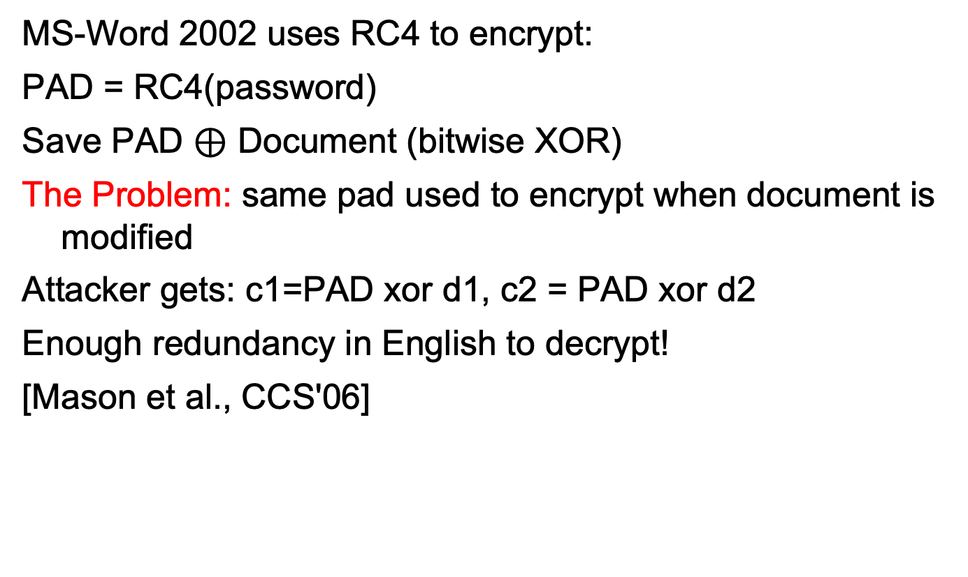
Example: Misusing Stream-Cipher
MS-Word 2002 uses RC4 to encrypt:
PAD = RC4(password)
Save PAD $⊕$ Document (bitwise XOR)
The Problem: same pad used to encrypt when document is modified
Attacker gets: c1=PAD xor d1, c2 = PAD xor d2
Enough redundancy in English to decrypt!
[Mason et al., CCS'06]
Cryptography is bypassed more often than broken!!

Slide 21
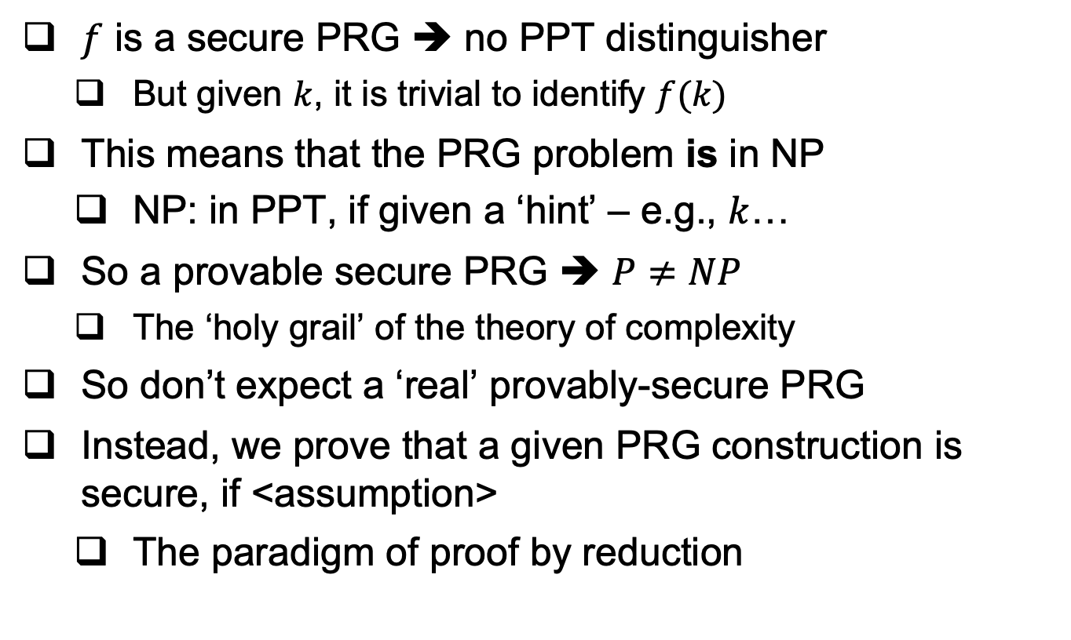
Provably-Secure PRG?
$f$ is a secure PRG ➔ no PPT distinguisher
But given $k$, it is trivial to identify $f(k)$
This means that the PRG problem is in NP
NP: in PPT, if given a ‘hint’ – e.g., $k$…
So a provable secure PRG ➔ $P≠NP$
The ‘holy grail’ of the theory of complexity
So don’t expect a ‘real’ provably-secure PRG
Instead, we prove that a given PRG construction is secure, if <assumption>
The paradigm of proof by reduction

Slide 22
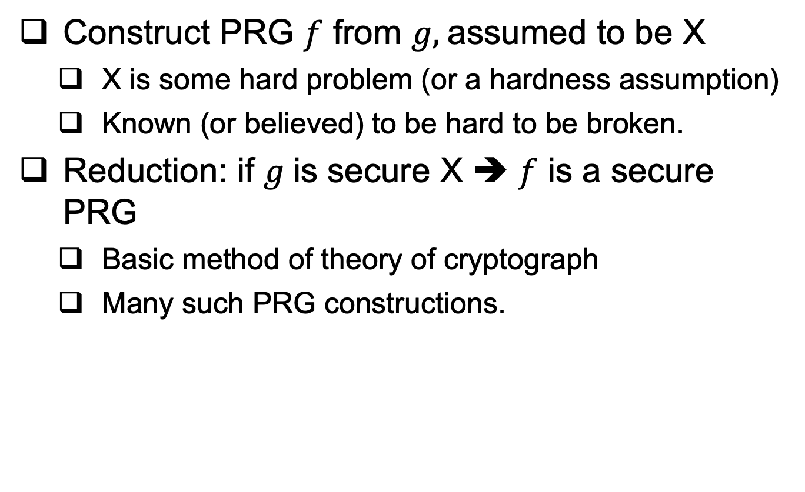
Provably-Secure PRG : by reduction
Construct PRG $f$ from $g,$assumed to be X
X is some hard problem (or a hardness assumption)
Known (or believed) to be hard to be broken.
Reduction: if $g$is secure X ➔ $f$ is a secure PRG
Basic method of theory of cryptograph
Many such PRG constructions.

Slide 23
Proof by Reduction
General paradigm (informal).
Use the new construction attacker (in this case it is the distinguisher D’) to build an attacker against the secure (smaller) construction (in this case it is the distinguisher D).
Analyze the success probability of D’ based on that.
Since the smaller construction is secure, the success probability of D’ will be also negligible, thus proving the security of the new construction.
Usually, it is easier to use proof by contrapositive.
Assume the new construction is insecure, then the smaller attacker will succeed with non-negligible probability → contradiction → the new construction is secure.

Slide 24
PRG by reduction – An Example
Let f : {0, 1}^{n} → {0, 1}^{n+1} be a secure PRG. Is f′ : {0, 1}^{n+1} → {0, 1}^{n+2}, defined as f′(b || x) = b || f(x), where b ∈ {0, 1}, also a secure PRG?
Steps/hints:
intuitively, is f’ a secure PRG? Why?
Formula for the advantage of D (attacker against f)
Formula for the advantage of D’ (attacker against f’)
Assume f’ is insecure, construct the attacker D using the attacker D’
Analyze the success probability and compute the advantage of D (in terms of the advantage of D’)
You will reach a contradiction saying that the advantage of D is non-negligible, why is that a contradiction?
Given the contradiction, this means that the assumption that f’ is insecure is wrong, thus it is secure.

Slide 26
Stream-Cipher Like but Stateless Encrypt?
PRG-based stream ciphers are stateful.
Need to remember how many bits (or bytes) were already encrypted, and and how many bits (or bytes) of PRG output have been used so far.
Can secure encryption be stateless?
The answer is…
Yes it can!
In three steps (or versions):
Use less state
Use no state with a random function
Use no state, but with pseudo-random function

Slide 27

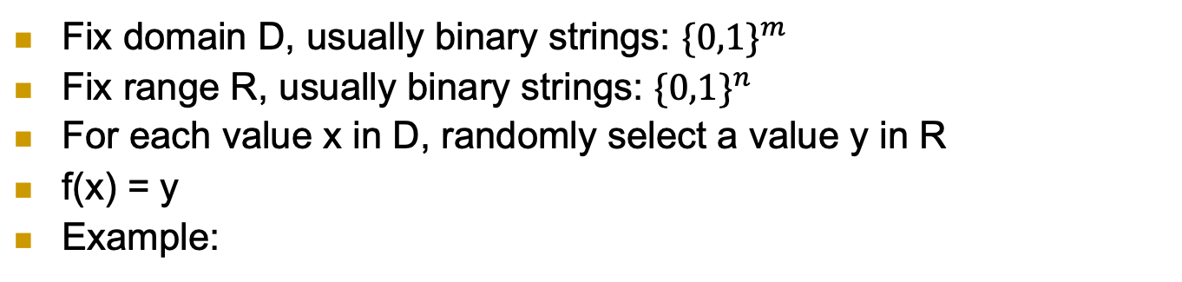

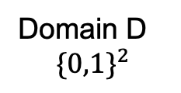
First, what’s a (‘truly’) random function f?
Fix domain D, usually binary strings: ${\{0,1\}}^{m}$
Fix range R, usually binary strings: ${\{0,1\}}^{n}$
For each value x in D, randomly select a value y in R
f(x) = y
Example:
 | f( )
00
01
10
11
Range R ${\{0,1\}}^{5}$
Domain D
$${\{0,1\}}^{2}$$

Slide 28
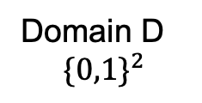

What’s a (‘truly’) random function?
Fix domain D, usually binary strings: ${\{0,1\}}^{m}$
Fix range R, usually binary strings: ${\{0,1\}}^{n}$
For each value x in D, randomly select a value y in R
f(x) = y
Example:
 | f( )
00 | 01101
01 | 11010
10 | 01101
11 | 11101
Range R ${\{0,1\}}^{5}$
Domain D
$${\{0,1\}}^{2}$$

Slide 29
What’s a (‘truly’) random function?
Another example:
Domain D: integers
Range R: bits {0,1}
For each integer i, randomly select a bit f(i)
Example:
i | f(i)
1
2
3
4
5
6
… | …
Range: bits {0,1}
Domain:
integers

Slide 30
What’s a (‘truly’) random function?
Another example:
Domain D: integers
Range R: bits {0,1}
For each integer i, randomly select a bit f(i)
Example:
i | f(i)
1 | 0
2 | 1
3 | 1
4 | 0
5 | 0
6 | 1
… | …
Range: bits {0,1}
Domain:
integers

Slide 31
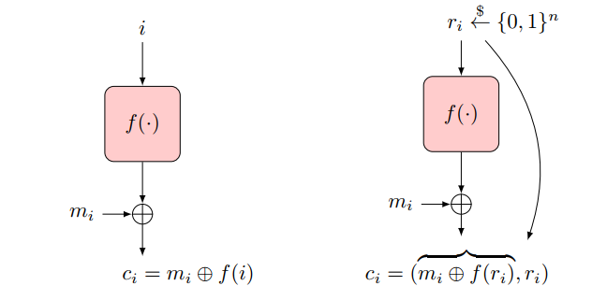
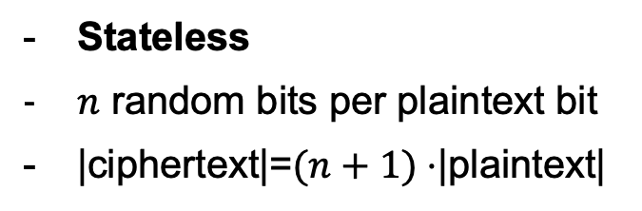
Random-Function-Based Encryption
Stateful (counter) Design
Randomized Design
Sync-state (counter)
No extra random bits required
|ciphertext|=|plaintext|
Stateless
$n$ random bits per plaintext bit
|ciphertext|=$(n+1)⋅$|plaintext|

Slide 32
Random-Function Bitwise-Encryption
Stateful (counter) Design
Randomized Design
Drawbacks:
Require random function (impractical)
Invoke function once-per-bit (computational overhead)

Slide 33
Reduce Overhead: Block-Encryption
Optimization: operate in blocks (say of n bits)
f be random function from n-bits strings (`blocks’) to n-bits strings (`blocks’)
p(i) be i-th block of n-bits of plaintext
c(i) be i-th block of n-bits of ciphertext
Challenge: sharing such random function f !!
Size of table? 2^{n} entries of n bits each…
Idea: use pseudo-random function (PRF) instead!

Slide 34
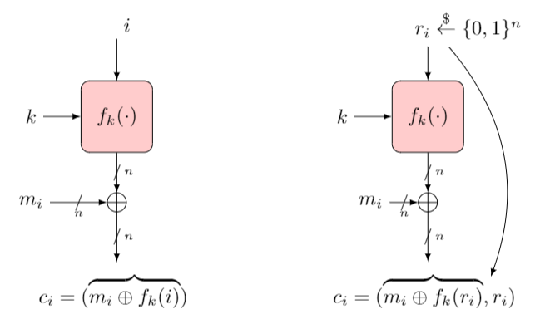

Encryption with PRF
Operate in blocks (say of n bits)
Use Pseudo-Random Function (PRF) $f_{k}(⋅)$, output n bits
Efficient , compact
But what’s a PRF ?

Slide 35
The PRF Indistinguishabity Test
F is a PRF from domain D to range R, if no distinguisher A:
Outputs 1 (signaling PRF) given oracle access to F_{k}(.) (for random n-bits key k ), and
Outputs 0 (signaling random) given oracle access to f(.), a random function (from D to R)
n-bit Key k
k
x₁,x₂,…,x_{i}
x₁,x₂,…,x_{i}
F_{k}(.)
?
f(.)
…, F_{k}(x_{i})
…, f(x_{i})
Box 1: PRF
Box 0: random function
A
1 if oracle is to F_{k}(.),
0 if oracle is to f(.)

Slide 36
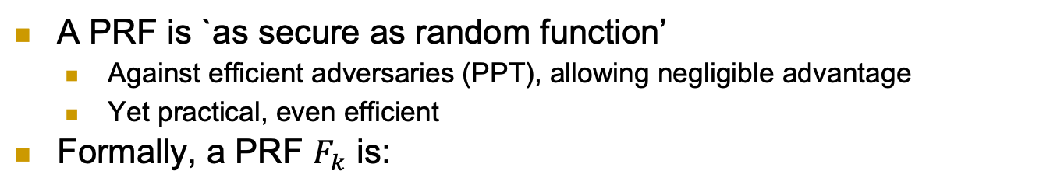
PRF Definition
A PRF is `as secure as random function’
Against efficient adversaries (PPT), allowing negligible advantage
Yet practical, even efficient
Formally, a PRF $F_{k}$ is:

Slide 37
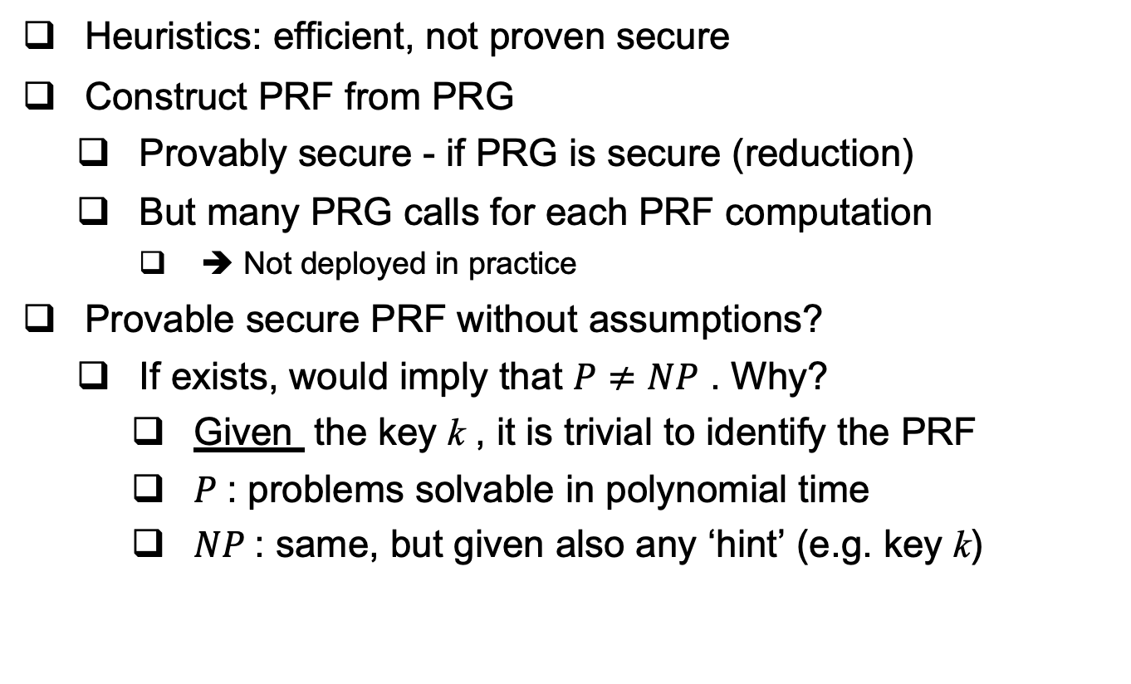
Constructing a PRF
Heuristics: efficient, not proven secure
Construct PRF from PRG
Provably secure - if PRG is secure (reduction)
But many PRG calls for each PRF computation
➔ Not deployed in practice
Provable secure PRF without assumptions?
If exists, would imply that $P≠NP$ . Why?
Given the key k , it is trivial to identify the PRF
$P$: problems solvable in polynomial time
$NP$: same, but given also any ‘hint’ (e.g. key k)

Slide 38
PRF Applications
PRFs have many more applications:
Encryption, authentication, key management…
Example: derive independent key for each day d
Easy, with PRF and single shared key k
Key for day d is k_{d} = F_{k}(d)
Exposure of keys of Monday and Wednesday does not expose key for Tuesday
Similarly: separate keys for different goals, e.g., encryption and authentication
d
Key k
PRF F_{k}
F_{k}(d)

Slide 39
Examples on the white board
Let Fk be a PRF, are the following PRFs and why?
F’_{k}(x) = F₁^{n}(x) || F_{k}(x)
F’’_{k}(x) = F_{k}(x) || lsb(F_{k}(x))
lsb is the least significant bit
The following PRF is secure, prove that formally (again using prove by reduction):

Slide 40
Covered Material From the Textbook
Chapter 2: section 2.5 and section 2.6
From 2.6.6, only what we covered in class

Slide 41

Thank You!

